Slide 1
Hands On Machine Learning
Chapter 03. Classification
Sin-sa
Kim YeChan
2024.09.10

Slide 2
INDEX
3.4 Multiclass Classification
3.5 Error Analysis
3.6 Multi-Label Classification
3.7 Multioutput-Multiclass Classification

Slide 3
3.4 Multiclass Classification
Multiclass Classification with Binary Classifier
OvR
One-versus-the-Rest
N class → N classifier
OvO
One-versus-One
N class → N x (N – 1) / 2 classifier

Slide 4
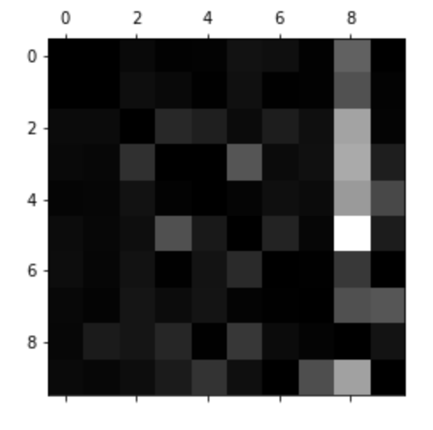
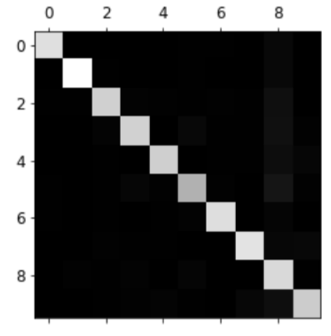
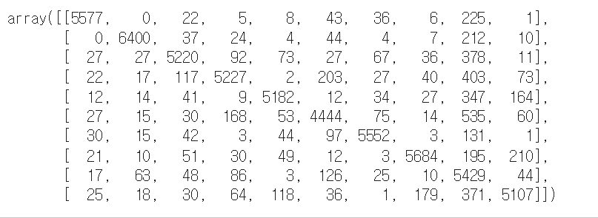
3.5 Error Analysis
Confusion Matrix Analysis
https://velog.io/@kyungmin1029/%ED%95%B8%EC%A6%88%EC%98%A8-%EB%A8%B8%EC%8B%A0%EB%9F%AC%EB%8B%9D-3.-%EB%B6%84%EB%A5%98

Slide 5
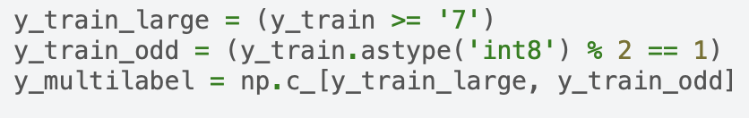

3.6 Multi-Label Classification
Multi-Label
Multi-Label Metrics
F1-score
Accuracy
…

Slide 6
3.7 Multioutput-Multiclass Classification
 | Multiclass Classification | Multi-Label Classification | Multioutput-Multiclass Classification
Number of outputs | single output | multiple labels | multiple outputs, multiple labels
Number of classes | One among multiple classes | Multiple classes, multiple labels | Multiple classes per output

Slide 7
Thank You For Listening

